Slide 1
Module 2: Implement Microsoft Teams governance, security and compliance

Slide 2
Module agenda
Implement governance and lifecycle management for Microsoft Teams
Implement security for Microsoft Teams
Implement compliance for Microsoft Teams

Slide 3
Graph can automate team lifecycles
Create a team
Archive or delete the team when the time comes
Add members and owners
Send a message
Configure team settings
Add tabs
Add channels
Install apps

Slide 4
Lesson 1: Implement governance and lifecycle management for Microsoft Teams

Slide 5
Lesson introduction
After this lesson, you will be able to:
Plan for governance in Microsoft 365 Groups
Create and manage Microsoft 365 Groups
Configure Microsoft 365 Groups expiration policy
Configure Microsoft 365 Groups naming policy
Analyze Teams usage reports

Slide 6
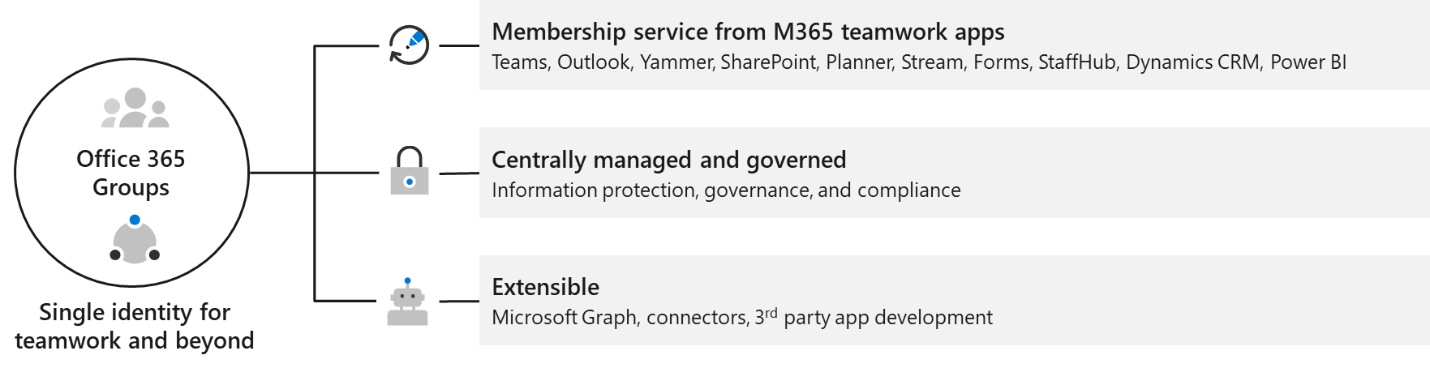
Plan for governance in Microsoft 365 groups
Microsoft 365 Groups is the cross-application membership service in Office 365
Following components are created when a team is created:
Microsoft 365 Group
Associated SharePoint document library
OneNote notebook
Connections with other Office 365 cloud applications
Notes:
Supporting videos for instructor or student use:
​Introducing Microsoft 365 Groups
https://www.youtube.com/watch?v=Cg-y3p4E8sA

Slide 7
Create and manage Microsoft 365 Groups
Create a new Microsoft 365 Group:
Users can create Microsoft 365 Groups in the three main communication applications in Office 365: Outlook, Microsoft Teams, and Yammer
Upgrade a distribution list to a Microsoft 365 Group
Strategies for Microsoft 365 Groups creation:
Microsoft 365 Group creation can be restricted to the members of a particular security group. This can be done with PowerShell
Manage a Microsoft 365 Group

Slide 8
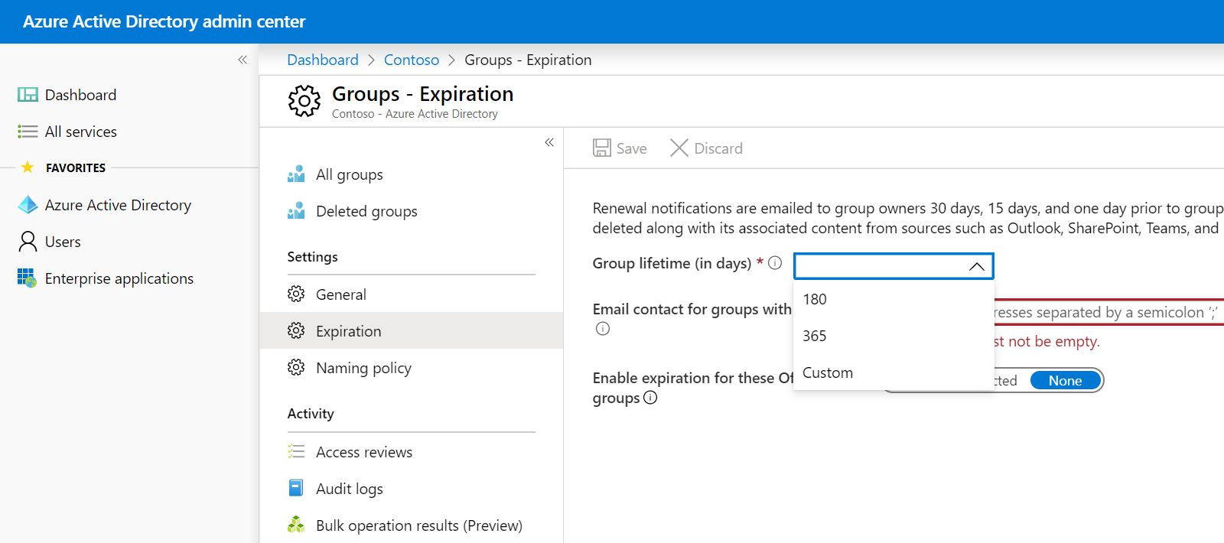
Configure Microsoft 365 Groups expiration policy
Configure the Microsoft 365 Groups expiration policy
Notification on a Groups expiration
30-day group restoration period
Notes:
Supporting videos for instructor or student use:
Governance, management and lifecycle in Microsoft Teams
https://www.youtube.com/watch?v=cOCWDYc_HLs&list=PLaSOUojkSiGnKuE30ckcjnDVkMNqDv0Vl
An expiration policy helps to remove inactive groups from the system. It is turned off by default, so the administrators need to enable it.
When a group expires, all of the groups associated services, such as the mailbox, Planner, SharePoint site will also be deleted (but there is 30 days recovery possibility)
Group expiration is a feature that is requires Azure AD Premium subscription.
Two types of roles with different privileges:
Office 365 global admin, User administrator - have full control
Users – can renew or restore an Office 365 Group that they own

Slide 9
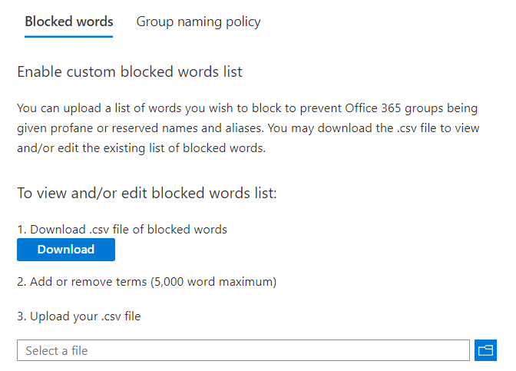
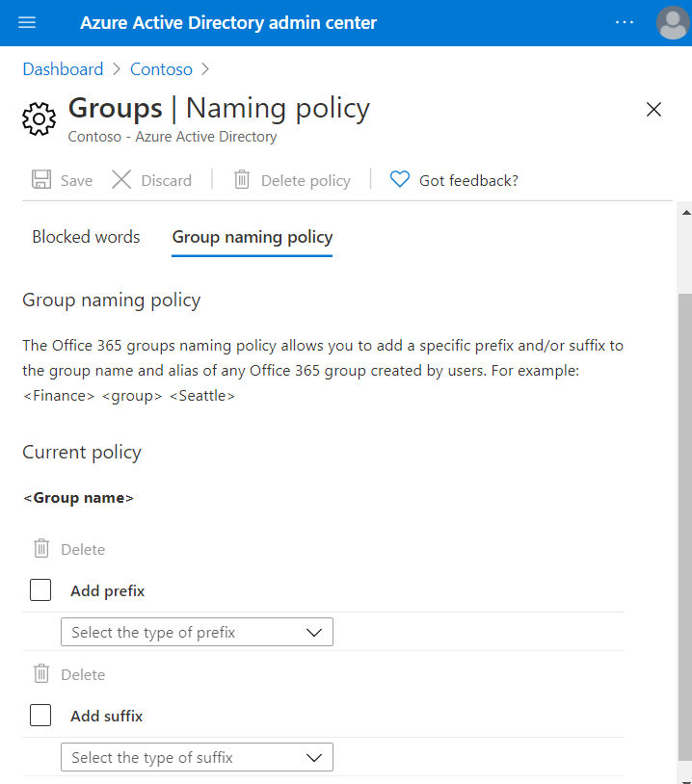
Configure Microsoft 365 Groups naming policy
Organizations can use a group naming policy to enforce a consistent naming strategy for groups created by users
Naming policy features:
Prefix-Suffix naming policy
Blocked words
Configured in Azure AD Admin Center
Naming policies require Azure AD Premium P1 or Azure AD Basic EDU license
Notes:
Supporting videos for instructor or student use:
Deploy Microsoft 365 Groups at scale to power Microsoft Teams, Outlook, Yammer, and SharePoint
https://myignite.techcommunity.microsoft.com/sessions/81555?source=sessions

Slide 10
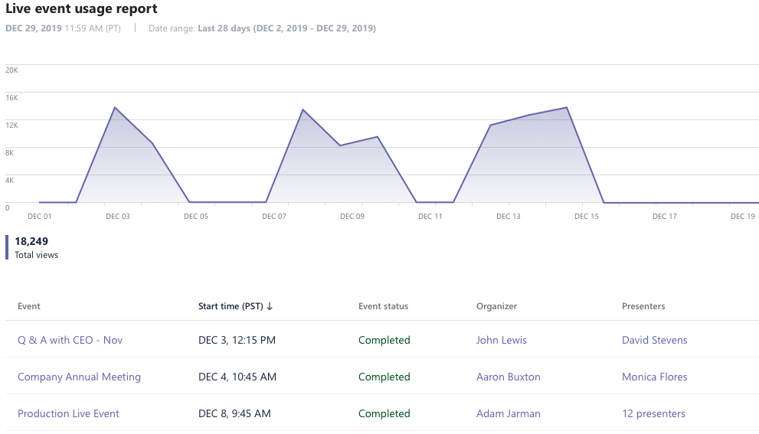
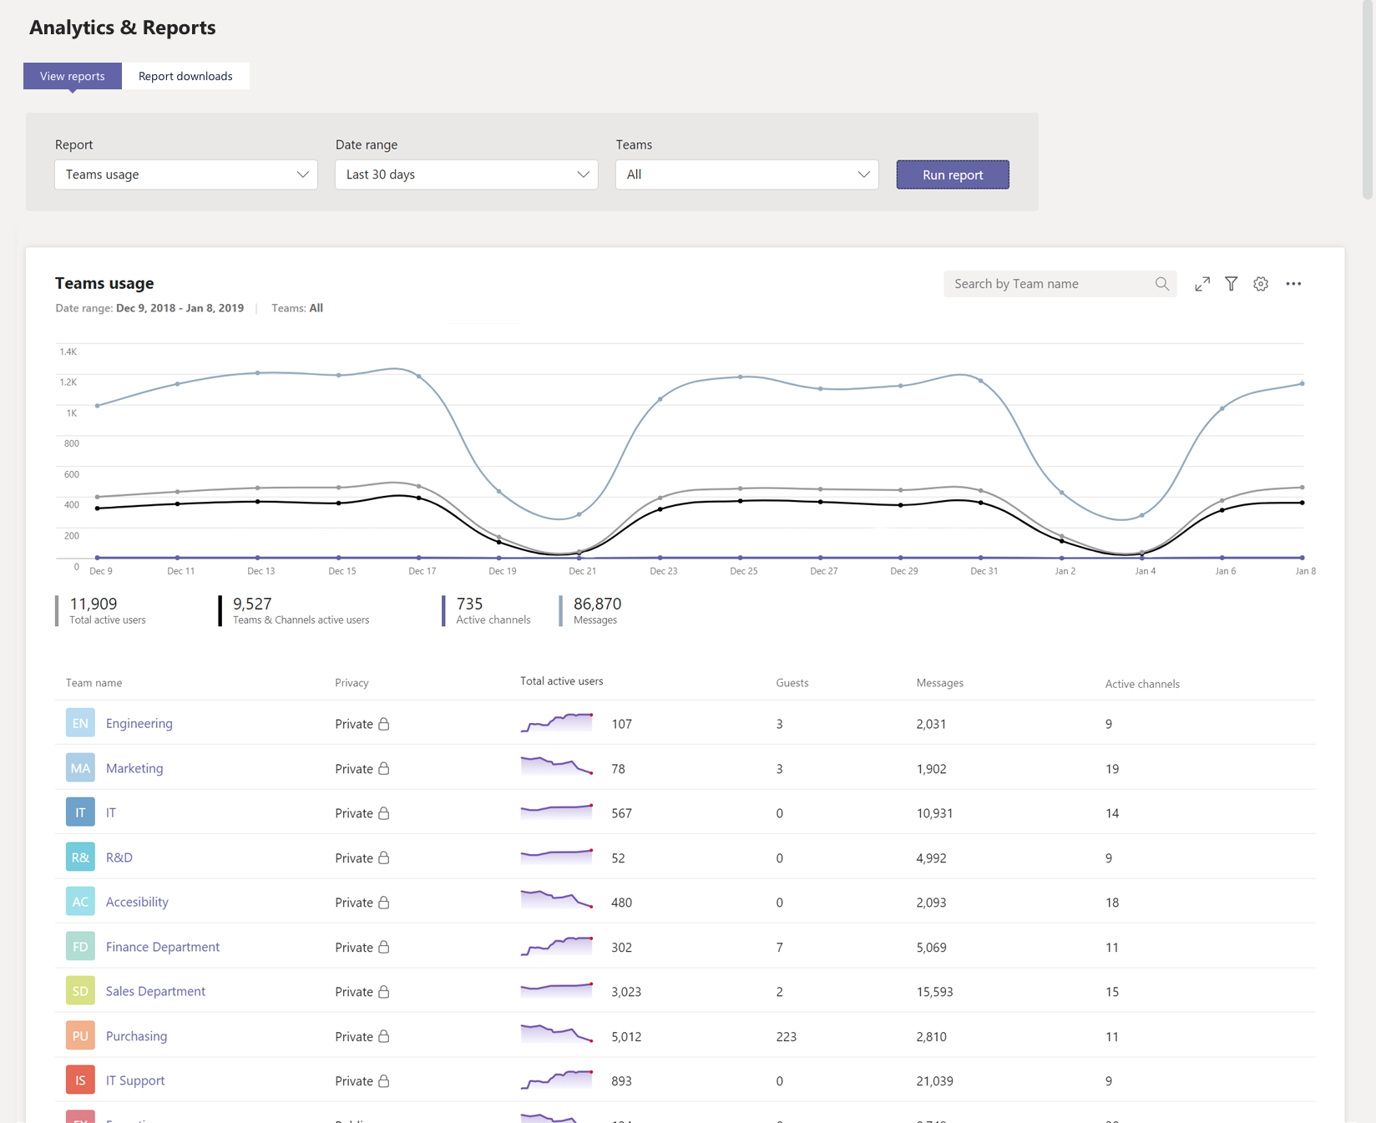
Microsoft Teams usage reports
Teams reporting, user level reporting, Live event usage reports in Teams admin center
Required roles:
Global admin in Microsoft 365 or Office 365
Teams service admin
Teams communications admin
Skype for Business admin
Available usage reports:
Teams user activity
Teams device usage
Teams usage
Teams live event usage
PSTN usage (Calling Plans and Direct Routing)
PSTN blocked users
PSTN minute pools report

Slide 11
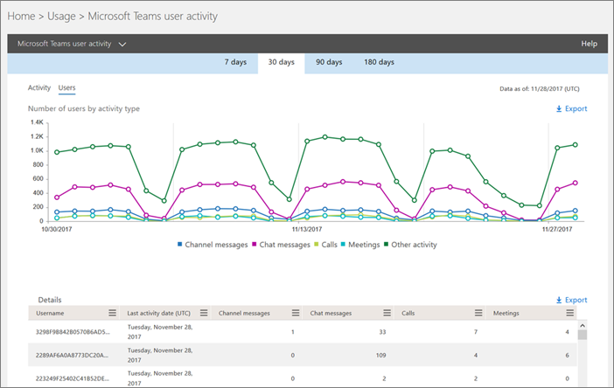
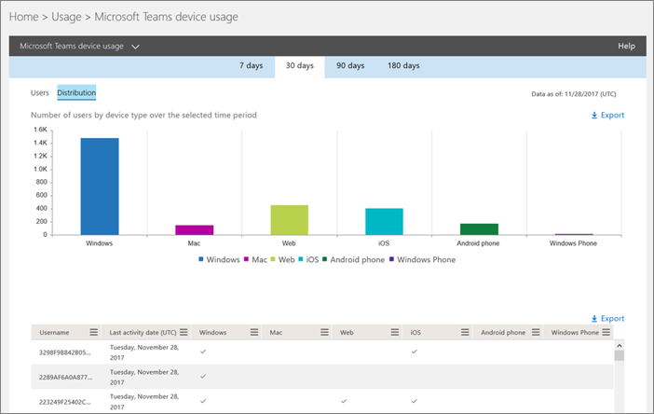
Microsoft 365 usage reports
Microsoft 365 usage analytics content represents a dashboard that provides a cross-product view and contains pre-built reports:
Microsoft 365 usage analytics (Power BI):
Executive summary
Overview
Activation and licensing
Product usage
User activity
Teams activity reports:
Microsoft Teams device usage report
Microsoft Teams user activity report

Slide 12
Lesson 2: Implement security for Microsoft Teams

Slide 13
Lesson introduction
After this lesson, you will be able to:
Explain Microsoft Teams authentication
Configure Conditional Access and Multi Factor Authentication (MFA) for Microsoft Teams
Assign Microsoft Teams admin roles
Implement Threat Management for Microsoft Teams
Describe security reports and alerts for Microsoft Teams

Slide 14
Microsoft Teams authentication
Microsoft Teams supports all the identity models which are available with Office 365, including:
Cloud identity
Synchronized identity
Federation identity
Multi-Factor Authentication (MFA)
Modern authentication to sign-in to Microsoft Teams
Notes:
Supporting videos for instructor or student use:
Identity models and authentication
https://www.microsoft.com/en-us/videoplayer/embed/RE2Pjwu

Slide 15
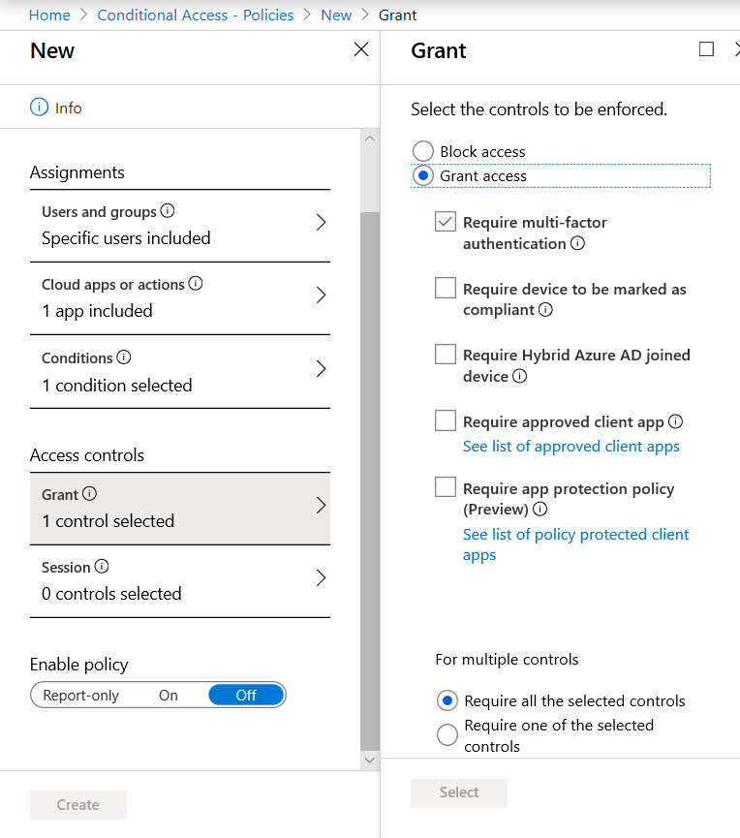
Configure conditional access and MFA for Microsoft Teams
Conditional Access policies apply actions to users who sign-in to apps from their devices depending on multiple conditions (such as group membership, IP location information, used device, accessed application)
Microsoft Teams is supported separately as a cloud app in Azure AD conditional access policies
Conditional access policies that are set for the Microsoft Teams cloud app apply to Microsoft Teams when a user signs in
To configure conditional access you need to access the Azure portal with a Global Admin role
Notes:
Supporting videos for instructor or student use:
Set up multi-factor authentication with a mobile device in Microsoft 365 Business
https://www.youtube.com/watch?v=Q8OzabuNwHI

Slide 16
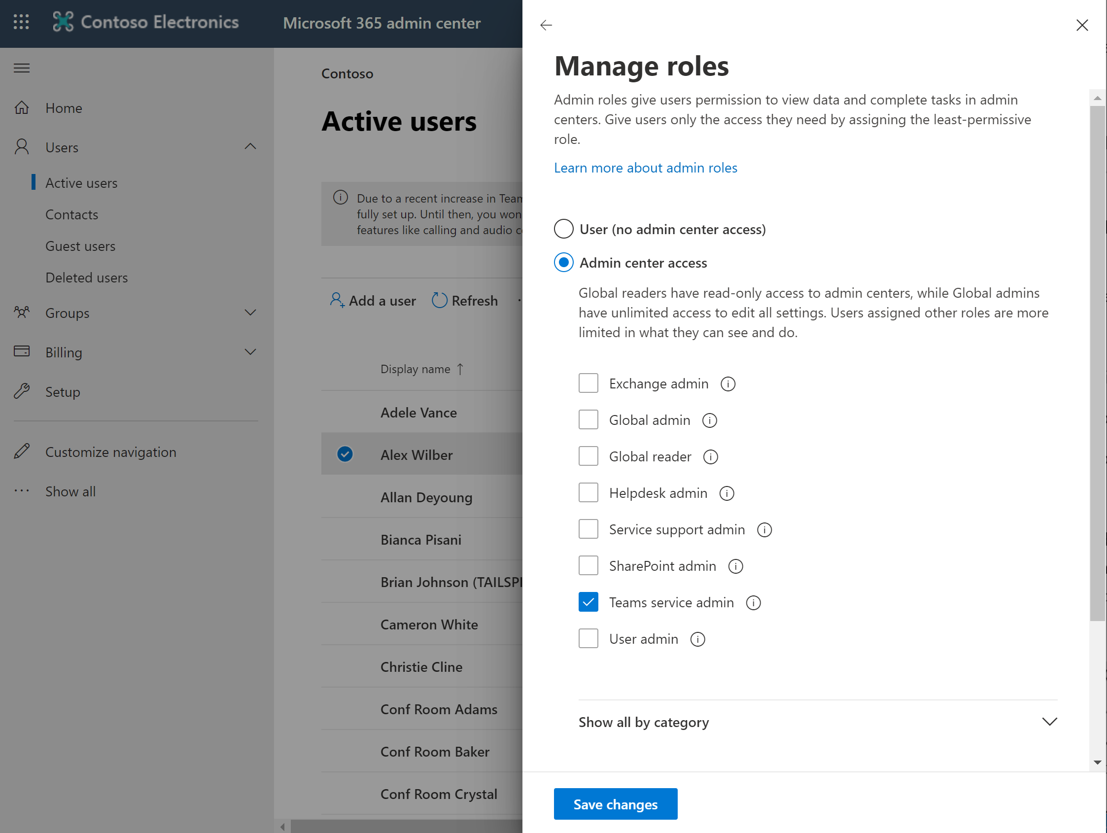
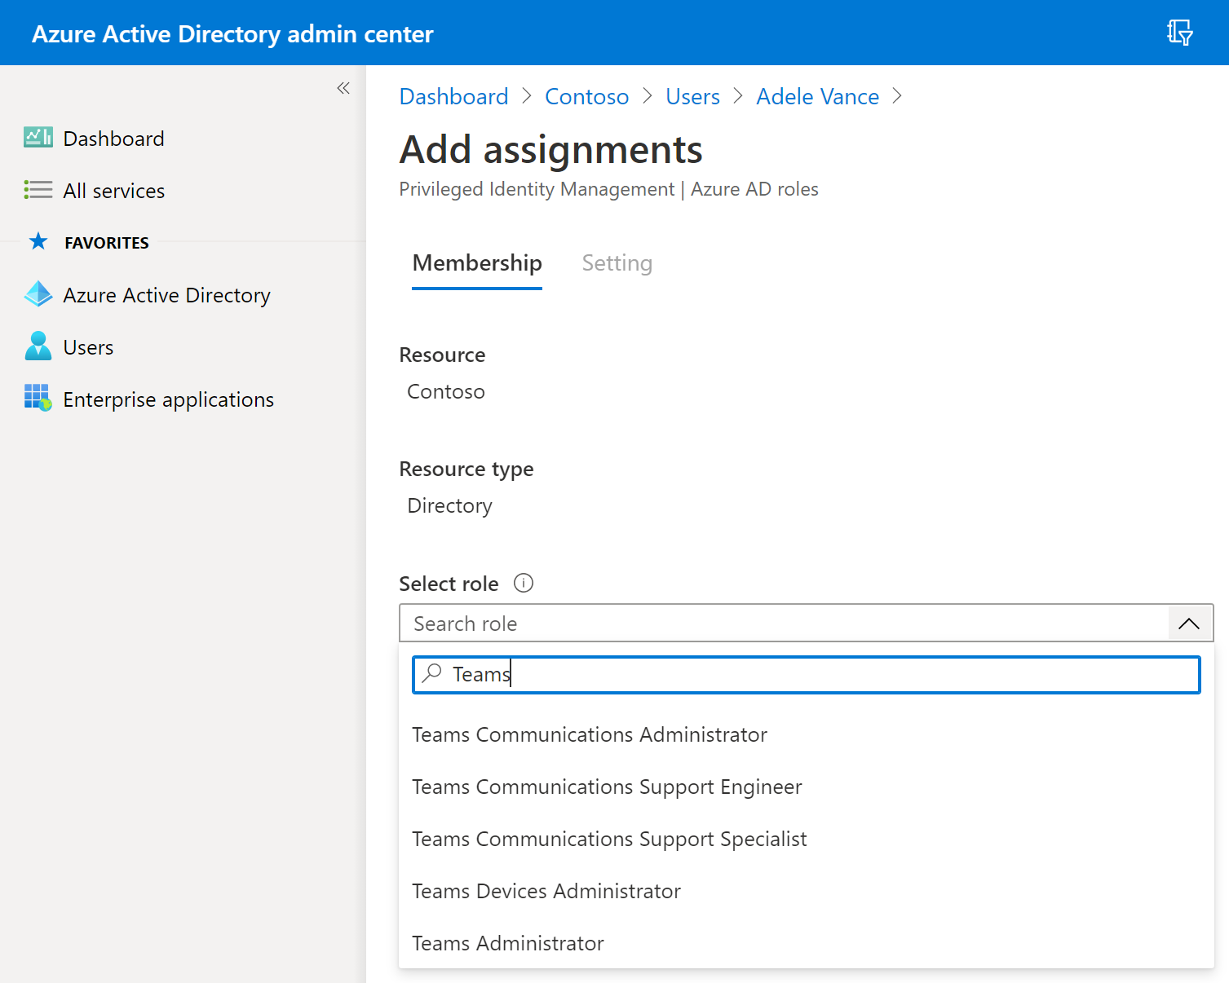
Assign Microsoft Teams admin roles
Global Admin can assign Teams admin roles via following means:
M365 admin center
Azure portal
PowerShell

Slide 17
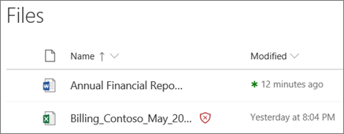
Implementing Threat Management for Microsoft Teams
Office 365 Advanced Threat Protection (ATP) helps organizations protect against malicious threats which may be posed by email messages, links (URLs) as well as through the collaboration tools users are using
Required roles to configure and assign ATP policies:
Office 365 Global Administrator
Security Administrator (Azure Active Directory admin center)
Notes:
Supporting videos for instructor or student use:
Advanced Threat Protection in Office 365
https://www.youtube.com/watch?v=idqTS6-_2t8
When a file stored in Teams, SharePoint Online or OneDrive for Business has been identified as malicious, ATP blocks access to the file.
Office 365 ATP features are accessed via the Microsoft 365 Security portal.

Slide 18
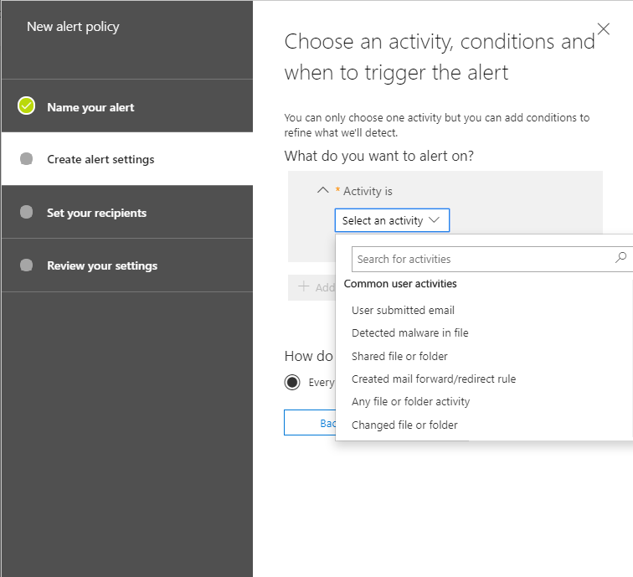
Security reports and alerts for Microsoft Teams
Microsoft 365 security center contains a dashboard that displays reports from
different sources:
Identities
Data
Devices
Apps
Threat Protection Status report
Alerts for malware files
Notes:
To view status and detailed information about files that were detected by Office 365 ATP you need to sign into Office 365 Security & Compliance Center
Security admins can create alert policies that will inform them when a shared document in SharePoint Online, OneDrive for Business, or Microsoft Teams has been identified as malicious.

Slide 19
Lesson 3: Implement compliance for Microsoft Teams

Slide 20
Lesson introduction
After this lesson, you will be able to:
Describe how sensitivity labels work and how to configure them
Describe how to create retention policies
Generate Data Loss Prevention policies to protect against data leakage
Create and manage eDiscovery cases and supervision policies
Deploy communication compliance for reviewing communication
Activate the scoped directory search in Teams
Manage data subject request cases in context of GDPR
Describe how information barrier policies work and how to create them
Configure alert policies for events in Microsoft Teams

Slide 21
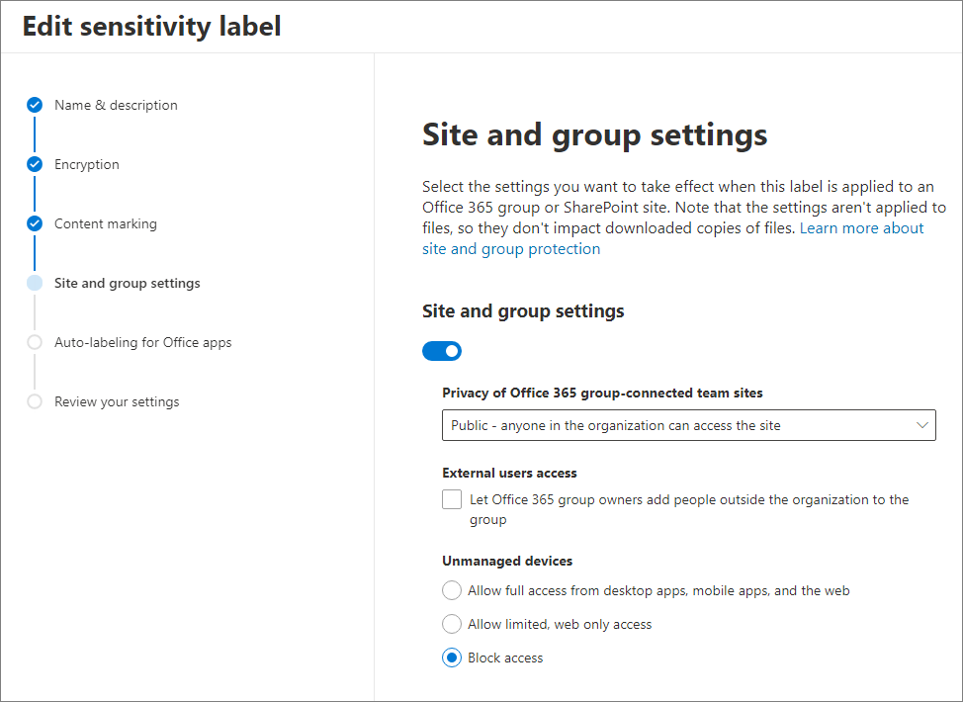
Create and manage sensitivity labels (1/2)
Sensitivity labels classify and protect organization's data.
Sensitivity labels can be applied to item level (documents and emails) or container level.
Sensitivity label settings for containers
External users access
Access from unmanaged devices
Privacy (public or private)
Notes:
Supporting videos for instructor or student use:
Enforcing your records management policies with Office 365
https://www.youtube.com/watch?v=CAUDKL4FyQ8

Slide 22
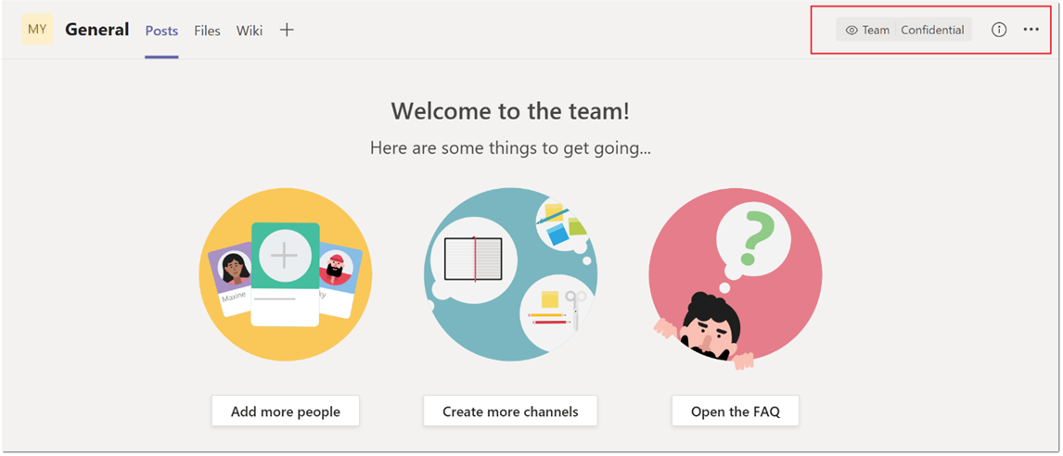
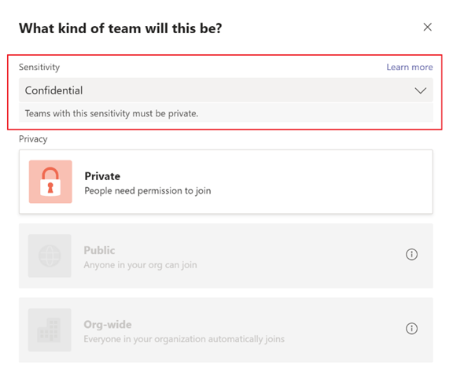
Create and manage sensitivity labels (2/2)
Enable sensitivity labels for containers
Import-Module AzureADPreview
Connect-AzureAD
$Setting = Get-AzureADDirectorySetting | where -Property DisplayName -Value "Group.Unified" -EQ
$Setting["EnableMIPLabels"] = "True"
Set-AzureADDirectorySetting -Id $Setting.Id -DirectorySetting $Setting
Create and publish sensitivity labels
Use sensitivity labels with Teams
Notes:
Supporting videos for instructor or student use:
Enforcing your records management policies with Office 365
https://www.youtube.com/watch?v=CAUDKL4FyQ8

Slide 23
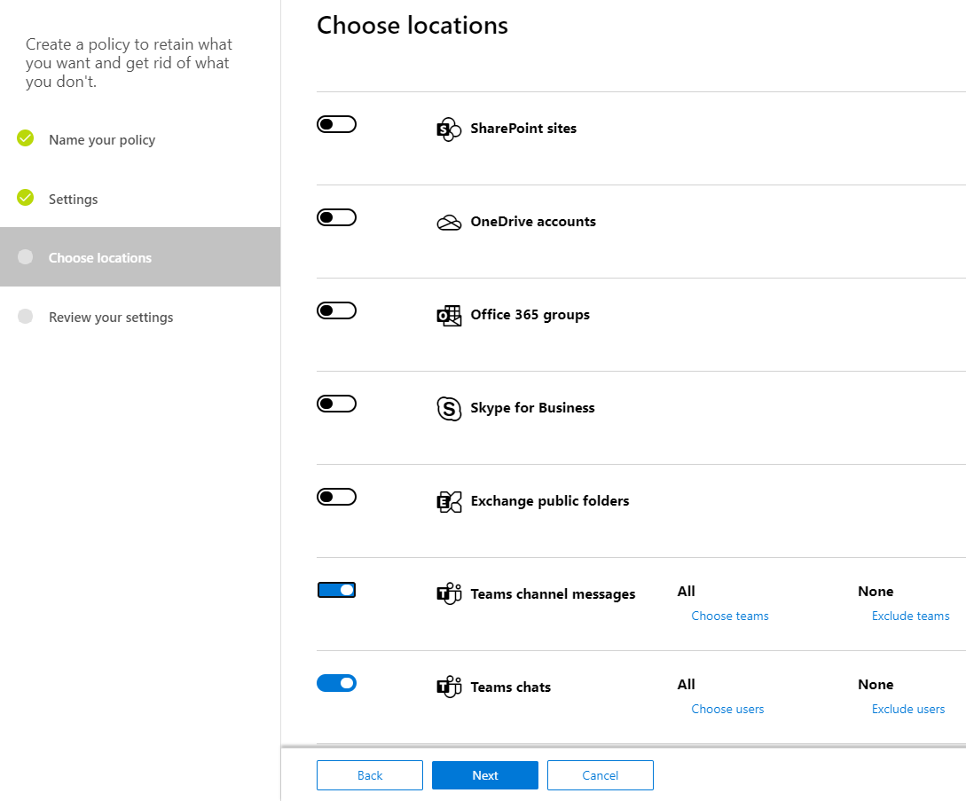
Create and manage retention policies
Retention policy settings
Retain-only : Retain content forever or for a specified period of time.
Delete-only : Delete content after a specified period of time.
Retain and then delete : Retain content for a specified period of time and then delete it.
Retention policy locations for Teams
Admins can set up separate retention policies for Teams private chats (1:1 or 1:Many chats) and Teams channel messages
Create a retention policy

Slide 24
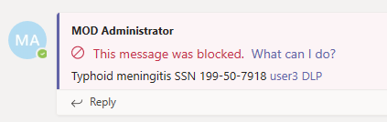
Create and manage DLP policies
Overview of Data loss prevention policies:
Identify sensitive information across many locations (Exchange Online, SharePoint Online, OneDrive for Business and Microsoft Teams)
Prevent the sharing of sensitive information by accident
Monitor and protect sensitive information in the desktop versions of Excel, PowerPoint and Word
View DLP reports (with content that matches your organization's DLP policies)
Notes:
DLP policies for Teams chats and channel messages licensing: Office 365 Advanced Compliance (available as a standalone option and is also included in Office 365 E5 and Microsoft 365 E5 Compliance).
DLP policies are managed in the Microsoft 365 compliance center, under Data loss prevention.

Slide 25
Create and manage eDiscovery cases
Available types of eDiscovery:
Content searches, to perform fast searches for content saved in one of the Office 365 services.
eDiscovery cases, to add holds and perform content searches in an organized case management structure (Core)
Advanced eDiscovery cases, to analyze large sets of unstructured data, that needs additional automation through relevance recognition (Advanced)
Create a new case
Place a hold on Microsoft 365 Groups and Microsoft Teams
Create and run a Content Search associated with a case
Preview and export the results
Considerations of eDiscovery for Microsoft Teams
Notes:
eDiscovery roles are assigned in the Security & Compliance Center, in Permissions section.
In Security and Compliance Center you can:
Create a new eDiscovery case
Place a hold on Office 365 Groups and Microsoft Teams
Create and run a Content Search associated with a case
Preview and export the results

Slide 26

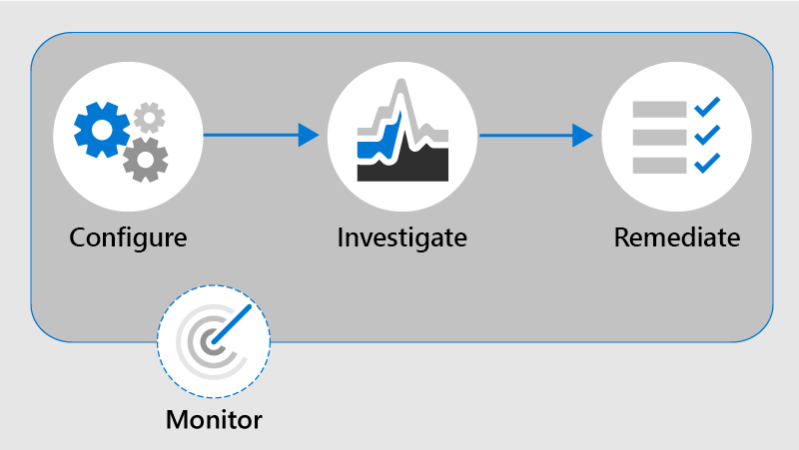
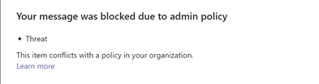

Deploy communication compliance
Supported communication types
Yammer
Microsoft Teams
Exchange Online
Third-party sources
Skype for Business Online
Policy tip for sender
Policy condition notification
Workflow
Policy tip for recipient

Slide 27
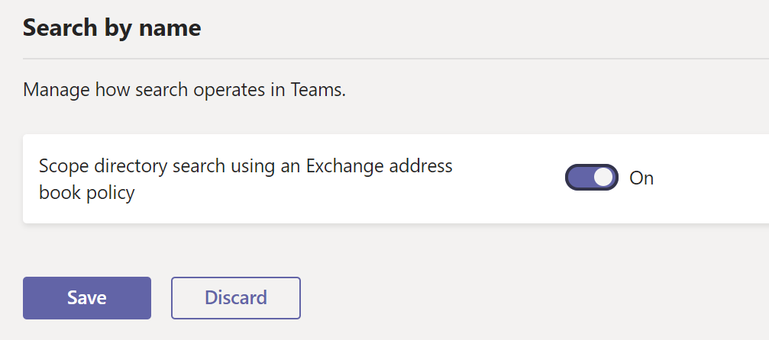
Use scoped directory search
With Microsoft Teams scoped directory search, the administrator can create virtual boundaries that control how users communicate with each other within the organization. For example:
Your organization has multiple companies within a single tenant, and you want to segment searches by companies
Limit chats between faculty and students, or different departments
Notes:
Scoped directory search can be turned on in Teams admin center.

Slide 28
Manage GDPR data subject requests
The (GDPR) defines the rights and restrictions on how to manage the personal data that has been collected by an employer or other organization
Use the DSR case tool in the Security & Compliance Center to find content stored in:
Any user mailbox in your organization
All mailboxes associated with an Office 365 Group and all team mailboxes in Microsoft Teams
All SharePoint Online sites and OneDrive for Business accounts.
All teams and Office 365 Groups
All public folders in Exchange Online
Notes:
The DSR tool can be found in the Security & Compliance Center, below Data privacy > Data subject requests or via the GDPR Dashboard.

Slide 29
Create information barrier policy
Information barrier policies are created when an administrator wants to restrict the communication between certain individuals or groups in Teams, including:
Searching for a user
Inviting someone to join a meeting
Adding a member to a team
Sharing a screen
Starting a chat session with someone
Placing a call
Starting a group chat

Slide 30
Create information barrier policy
Prerequisites for information barriers
Define policies for information barriers
Part 1
Segment users in your organization
Part 2
Define information barrier policies
Part 3
Apply information barrier policies

Slide 31
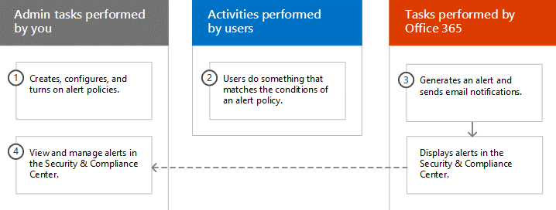
Create security and compliance alerts for Microsoft Teams
Alert policies help administrators identify events in their tenants that could indicate a security breach, an abuse of administrative privileges or other activities that require monitoring
Notes:
Supporting videos for instructor or student use:
Office 365 Audit Logging and Monitoring
https://www.youtube.com/watch?v=k2Ie9F7bQ5s
Alert policies and the alert dashboard are available in the Security & Compliance Center and via the Security & Compliance Center PowerShell module.
Alert policies require auditing enabled in a tenant.

Slide 32
Lab: Implement governance and lifecycle management for Microsoft Teams

Slide 33
Lab exercises
Exercise 1: Implement governance and lifecycle management for Microsoft Teams
Exercise 2: Implement security for Microsoft Teams
Exercise 3: Implement compliance for Microsoft Teams

Slide 34
Closing Slide

